Slide 1
Beyond the Horizon
Enhanced Panoramas
Abhishek Verma | 234101002
Ajaypal Singh | 234101005
Dhruv Kakadiya | 234101013
Jash Ratanghayra | 234101009
Kishan Thakkar | 234101024

Slide 2
Problem Statement
Creating high-quality panoramic images remains challenging due to issues like misalignments and exposure differences. This project aims to use a different image processing algorithm that significantly improves panorama seamlessness and overall visual quality.

Slide 3


A
R
C
H
I
T
E
C
T
U
R
E

Slide 4
CHALLENGES FACED
RESOLVED
FUTURE WORK
Optimal Threshold Estimation
Occurrence of Blank Spaces
Extension to Multi-Image Stitching
Motion-induced Inconsistencies
Brightness and Contrast Disparity

Slide 5
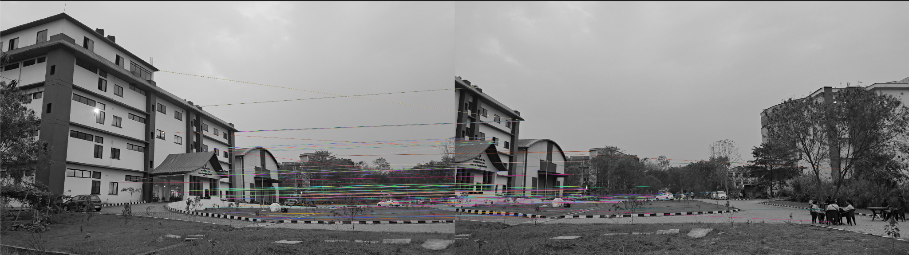
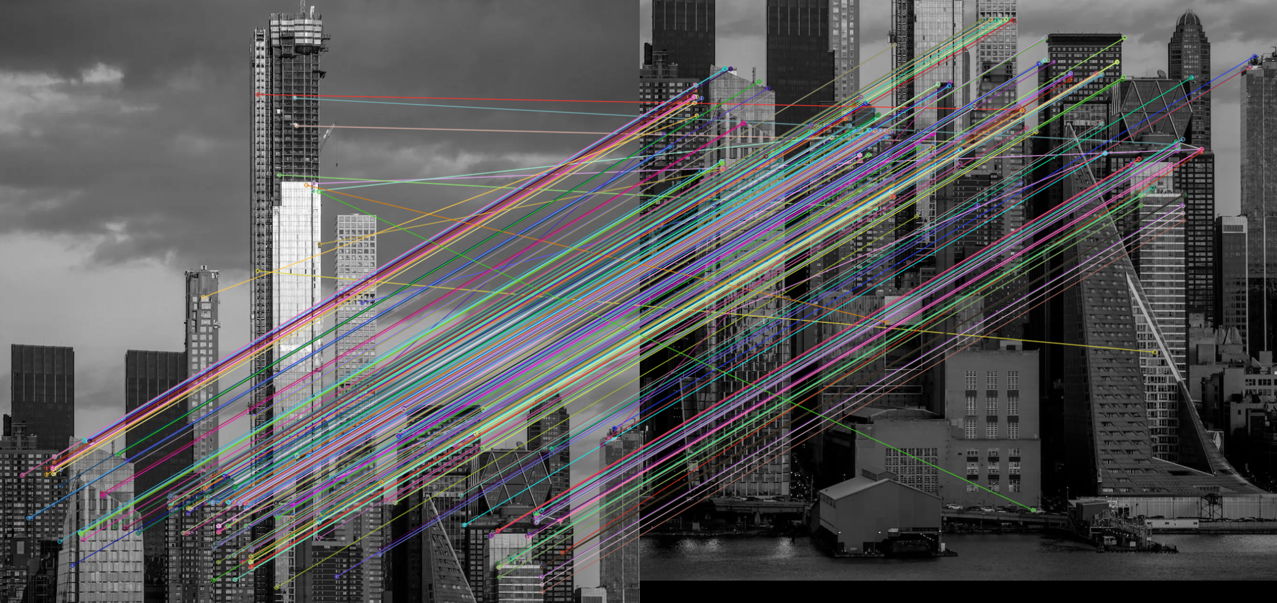
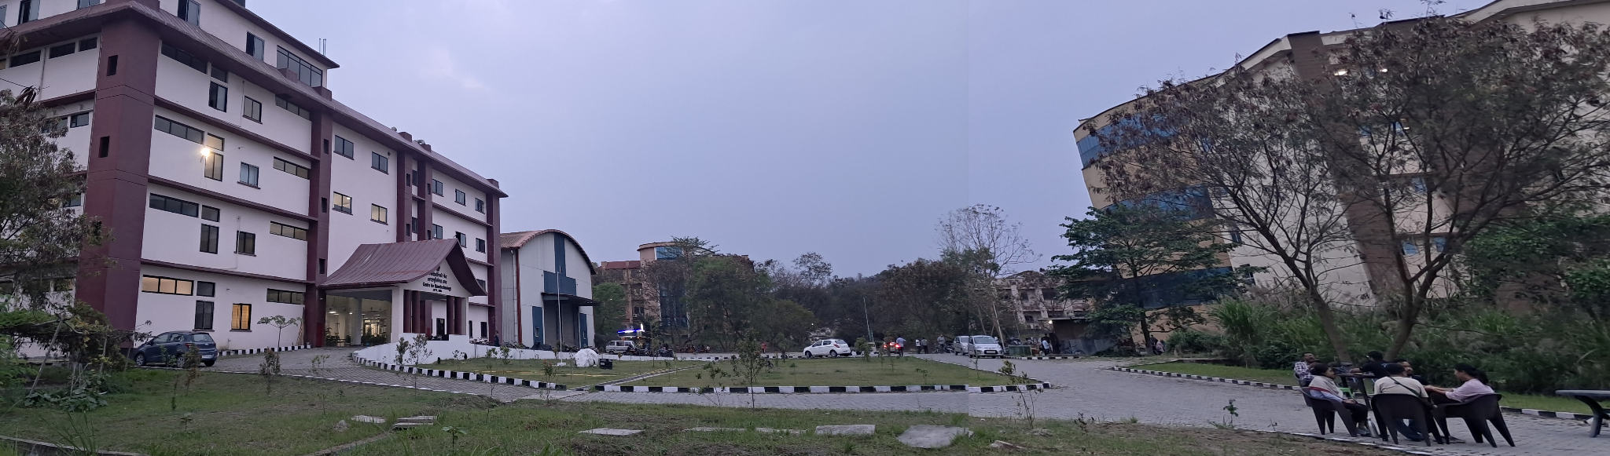
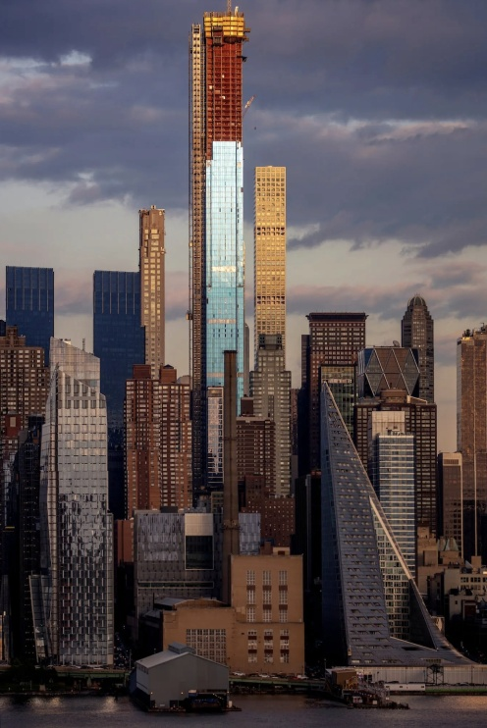
Results Obtained

